Slide 1


E-Shop
E-Shop: An online platform where businesses sell products or services, offering convenience, variety, and secure transactions for customers worldwide.

Slide 2

Team - Nhim Kevin
-
-
-

Slide 3
01
02
🏆
The Selection
Fronend
Backend
we create different 4 page and 2 role
Frontend
Backend
User Role
Admin Role
03
04
User
Admin

Slide 4



User
Admin
Only Buy
Web Controller
A user can only join website and buy something on the web, user can use cart, reviews, and add fav the item
A @min can control everything on website. Such as posting and managerment, admin can also create user
For admin role and user role

Slide 5
User comparison
Competitors | User | Admin
Access Backend | ✔ | ✔
Access Frontend | ✔ | ✔
Create User | ❌ | ✔
Manage Shipment | ❌ | ✔
Buy Item | ✔ | ✔
Posting | ❌ | ✔

Slide 6



User

Slide 7
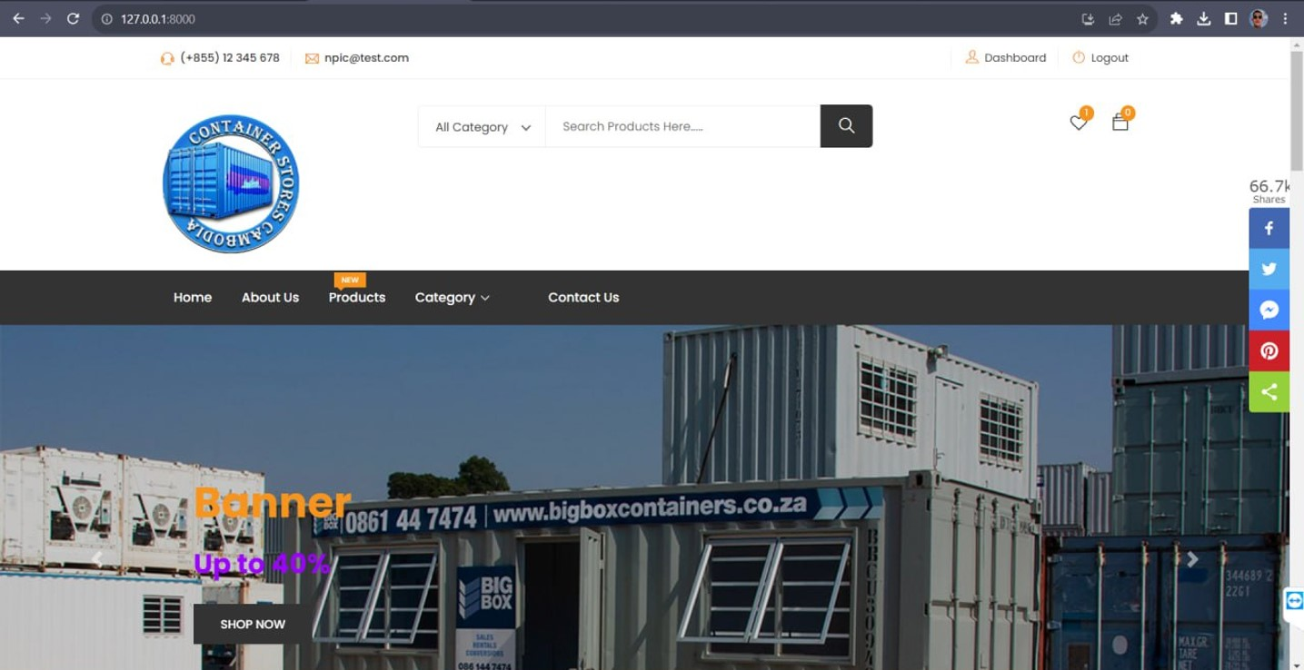

Slide 8
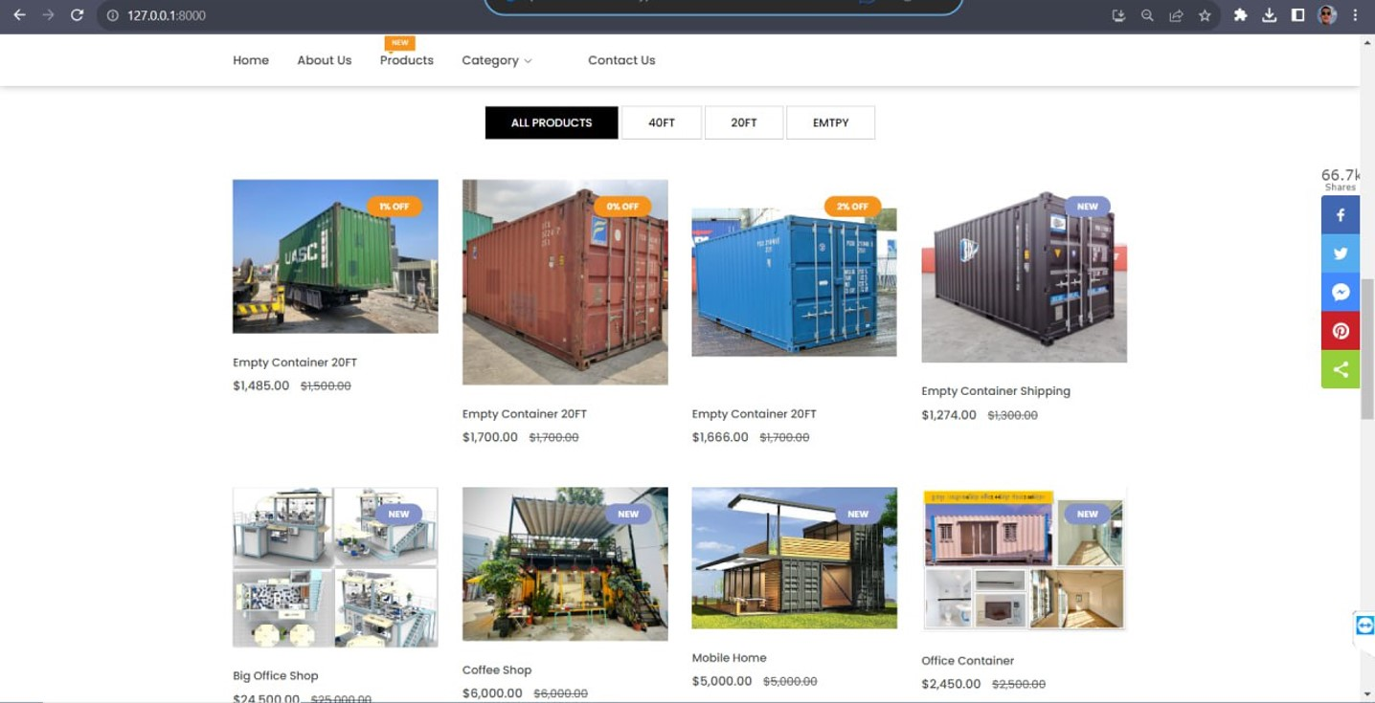

Slide 9
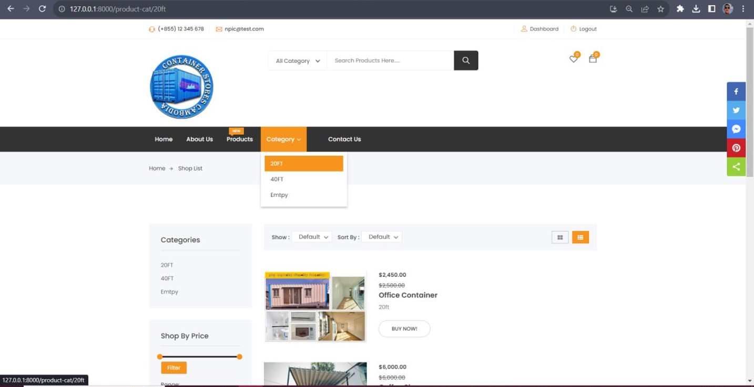


Slide 10
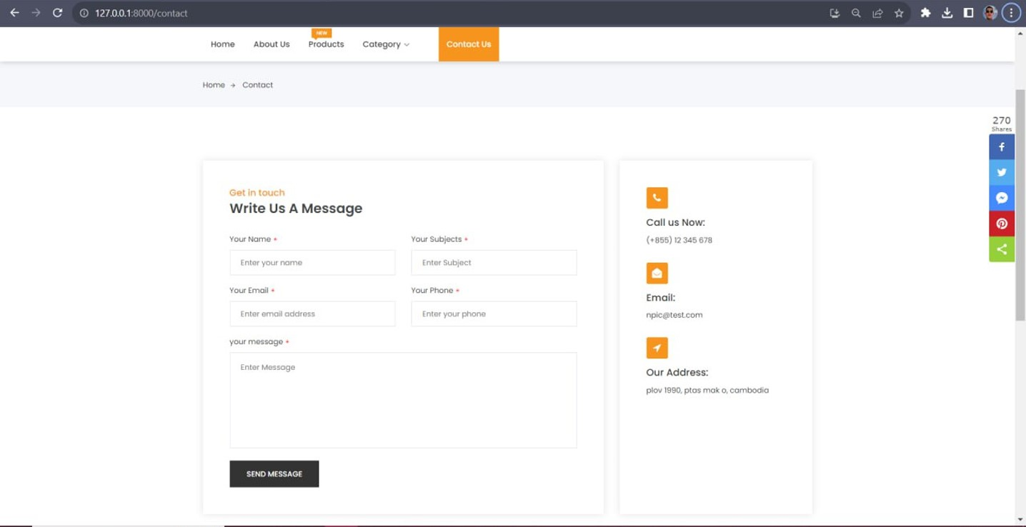

Slide 11
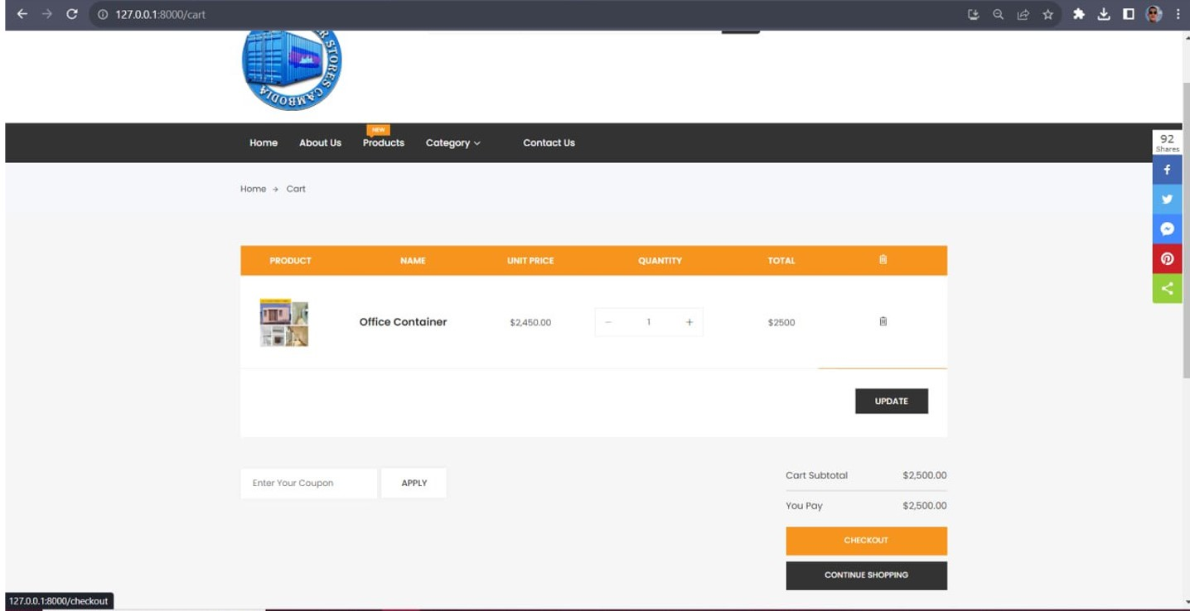

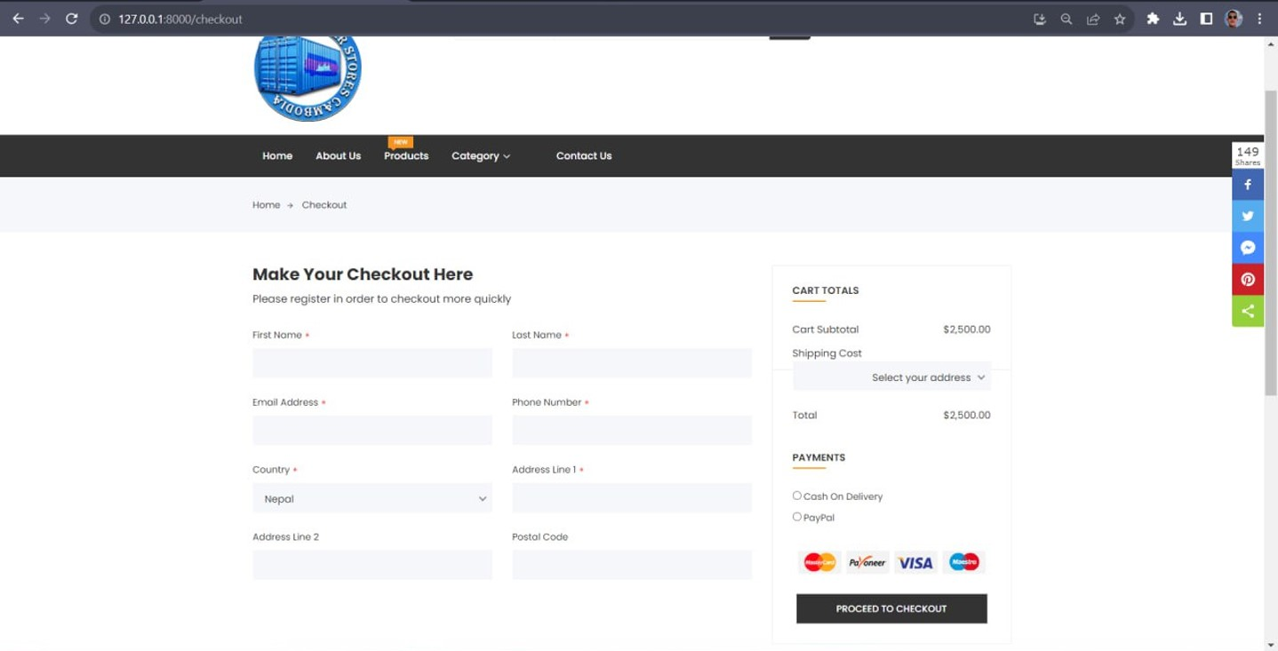



Add to cart
User can add item in cart, user can change to item value or delete the item and click update to refresh.
Check out
Every item will store in check out page. For user to confirm the product price, the user need to add some info like. Email, phone number ……

Slide 12
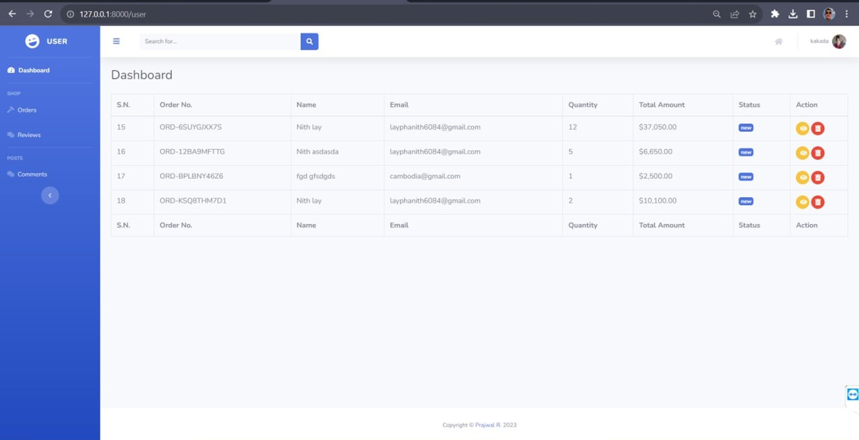

Slide 13



Admin

Slide 14
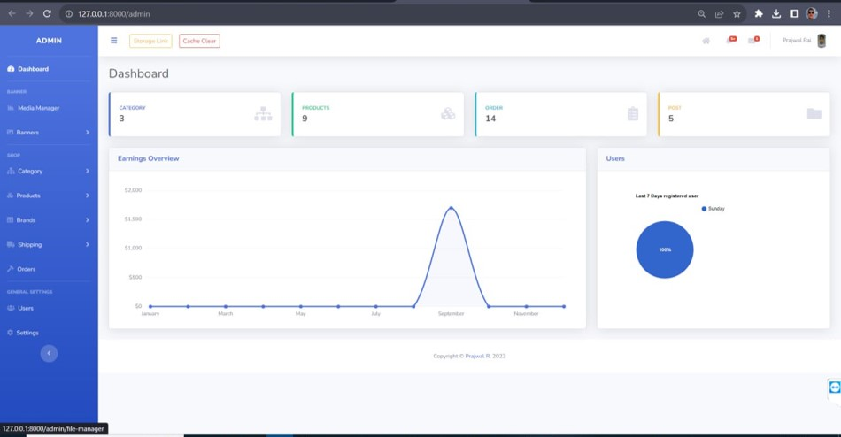

Slide 15
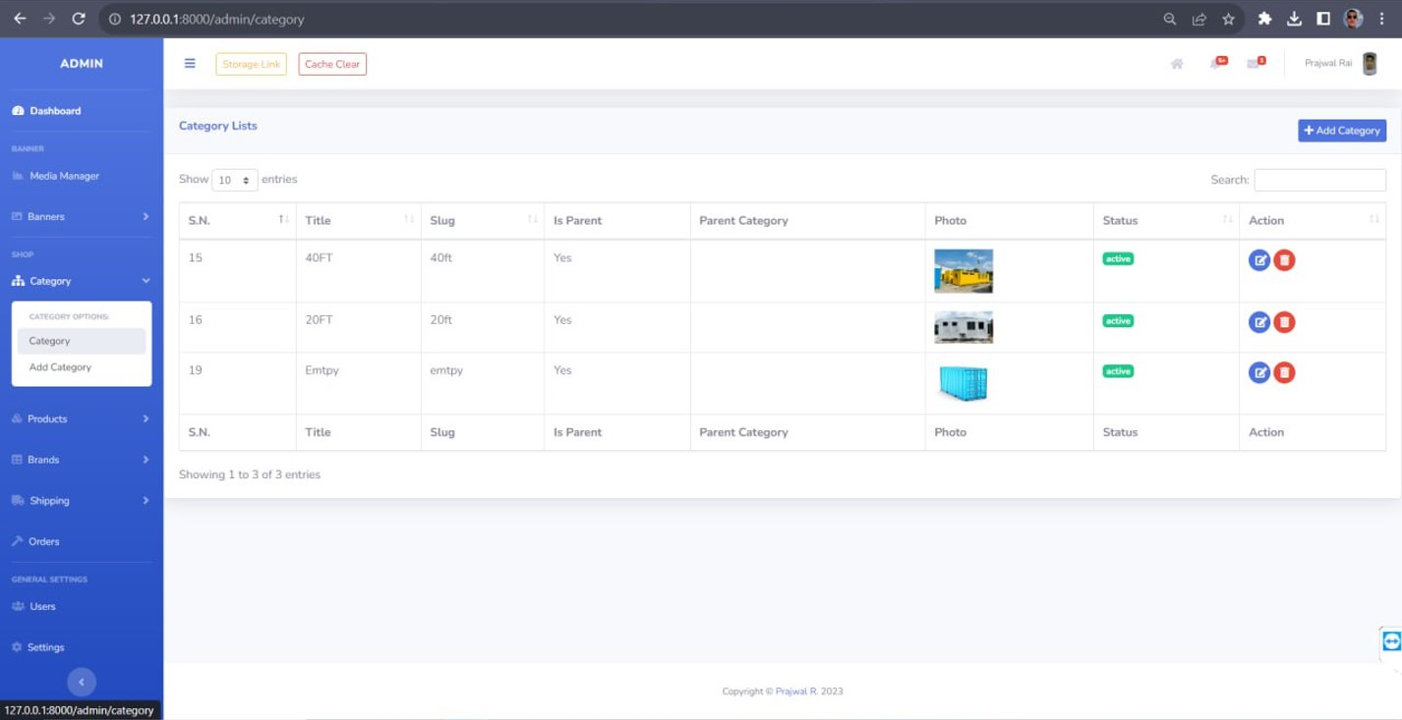


Slide 16

Step to Create Product
01
Create Category
03
Create Product
02
Create Brand

Slide 17
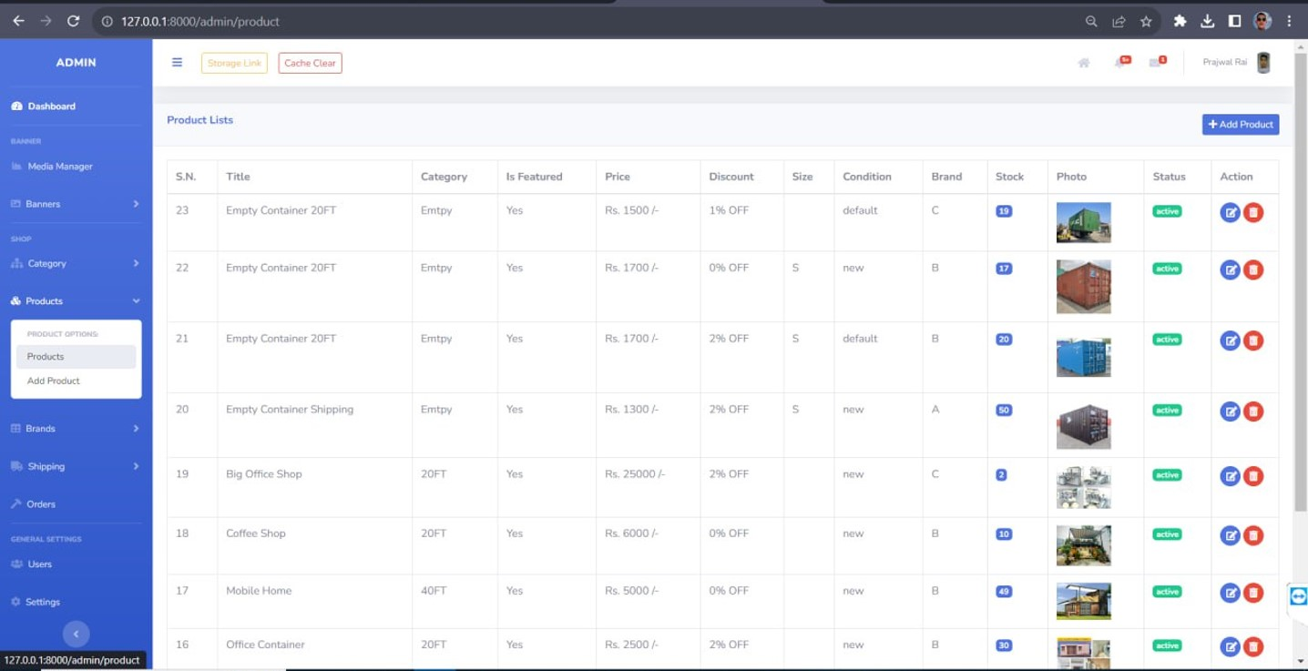

Slide 18

No questions right !?

